Slide 1
CLINICAL EPIDEMIOLOGY UNIT
Nicolae Testimițanu State University of Medicine
and Pharmacy of the Republic of Moldova
05 November 2019

Slide 2
CLINICAL EPIDEMIOLOGY UNIT
TEAM PRESENTATION
Part 1
Part 2
SHORT HISTORY OF THE CLINICAL EPIDEMIOLOGY UNIT
Part 3
MAIN TEACHINGS, COURSES IN RESEARCH METHODOLOGY FOLLOWED BY UEC MEMBERS
Part 4
PROJECTS REALIZED (OR IN PROGRESS) WITHIN THE MEMBERS EUC
Part 5
MAIN PUBLICATIONS AND SCIENTIFIC COMMUNICATIONS OF MEMBERS UEC
Part 6
CLINICAL EPIDEMIOLOGY UNIT DEVELOPMENT PROJECTS FOR THE FOLLOWING 5 YEARS

Slide 3
CLINICAL EPIDEMIOLOGY UNIT
Part 1
TEAM PRESENTATION

Slide 4
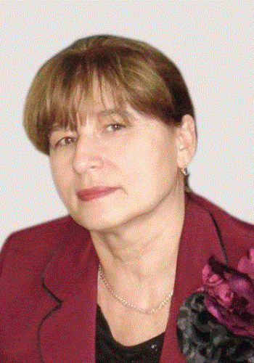
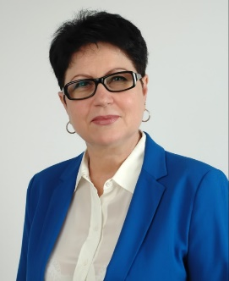
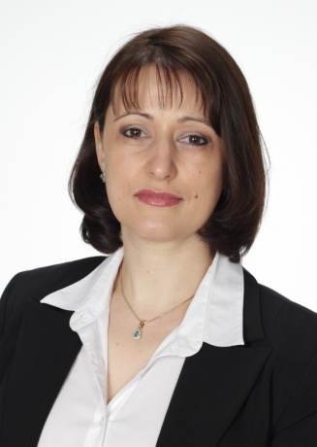
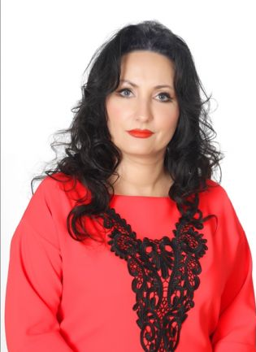
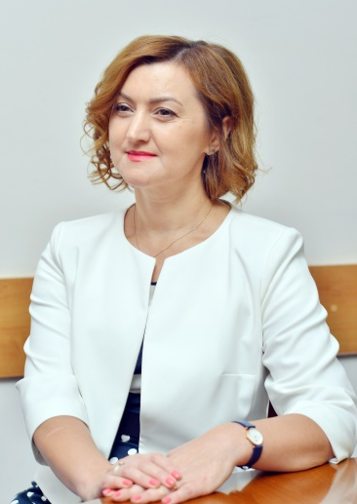
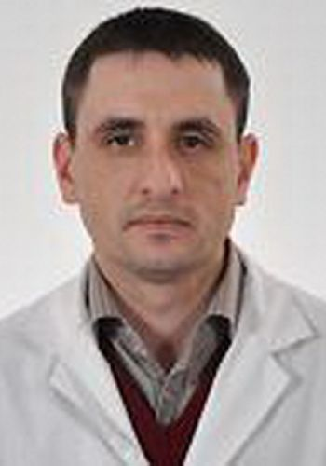
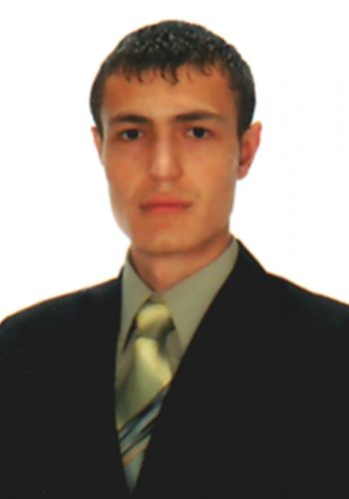
I. TEAM PRESENTATION
coordonator UEC
Mmbers
UEC
Larisa Spinei,
PhDH, professor
Svetlana Hadjiu,
PhDH, professor
Stela Adauji,
PhD, associate professor
AureliaSpinei,
PhDH, associate professor
Snejana Vetrilă,
PhD, associate professor
Oleg Arnat,
PhD, associate professor
Pavel Banov,
PhD, assitant

Slide 5
Larisa Spinei
PhDH MD in medical science, Professor;
Head of the Management and Psychology Department;
Studies: State Institute of Medicine of Chisinau, Faculty of General Medicine (1970-1976);
STMPh , postgraduate studies felowship in Social medicine and management, Postoctorate degree, PhDH (1994-1997)
Scientific specialty: 331.03 Social medicine and management
Research fields: Social medicine, Research Methodology, Biostatistics, Evidence-Based Medicine
Expertise activities: Member of the World Academy of Medical Sciences (International Board of Biostatistics), Netherlands (2015 – in present); Members of the Scientific Seminares on "331.03 Social medicine and management " and "321.15 Obstetrics and gynecology"profile in the Republic of Moldova (2010 – in present); Vice-chair of the Research Ethics Committee, (2015 – 2018); Member of the Methodological Committee of the Community medicine profile (2017 – in present); Expert in medical research within the National Agency for Quality Assurance in Education and Research cercetarea medicală (2017 – in present);
Coordinator Clinical Epidemiology Unit, (2019 – in present);

Slide 6
Svetlana Hadjiu
PhDH MD in medical science, Professor, Department of Pediatrics;
Studies: State Institute of Medicine of Chisinau, Faculty of of Pediatrics (1979-1985);
Scientific specialty: 321.05 - Clinical Neurology
Research fields: Medicine: Neuropediatrics, Neurology, Pediatrics
Expertise activities: Member of the Scientific Seminar on Pediatrics and Neonatology; Member of the Clinical Neurology Profile Seminar; Member of the SUMF Ethics Committee "Nicolae Testemitanu"; Member of the Clinical Research Unit (CRU) of the SUMF “Nicolae Testemitanu”; Member of the MSMPS Neurology Specialty Commission; Member of the editorial board of the Journal of Neurology and Psychiatry of the Child and Adolescent in Romania

Slide 7
Stela Adauji
Studies: Nicolae Testemitanu State University of Medicine, Faculty of Pharmacy (1991-1996); The School of Management in Public Health, Nicolae Testemitanu SUMPh (2012-2014);
PhD in pharmacy, Associate professor, Head of Vasile Procopisin Social Pharmacy Department, Head of Quality Management Unit
Research fields: Pharmaceutical management and marketing, pharmaceutical legislation, social pharmacy, information technologies in pharmaceutical activity, pharmacy economics;
Scientific specialty: 316.01 Pharmacy
Expertise activities: Member of the specialized Commission of Pharmacy of the Ministry of Health, Labor and Social Protection. Order of MHLSP no. 1002 of 10.09.2019 (2019 – in present); Member of Clinical Epidemiology Unit, Nicolae Testemițanu SUMPh (2019 – in present); Expert in evaluating study programs within the National Agency for Quality Assurance in Education and Research (2018 – in present); Permanent member of the Medicines Commission within Agency of Medicines and Medical Devices (2015 – in present);

Slide 8
Aurelia Spinei
Studies: Nicolae Testemitanu State University of Medicine, Faculty of Dentistry (1984-1989); Nicolae Testemitanu State University of Medicine, Clinical secondary school, Pediatric dentistry (1989-1991)
PhD MD in medical science, Associate Professor, Ion Lupan Pediatric oro-maxillofacial Surgery and Pedodontics Department
Research fields: Cariology, Prevention of dental conditions, Antibacterial photodynamic therapy;
Scientific specialty: 323.01 Dentistry
Expertise activities: Member of Clinical Epidemiology Unit, Nicolae Testemițanu SUMPh (2019 – in present); Member of the Editorial Board of the Journal of Contemporary Dentistry, Minsk, Belarus (impact factor - 0.319) (2018-present); Member of the Editorial Board of the Romanian Journal of Dental Medicine, Bucharest. ISSN 1841-6942 (2015 – present);Member of the Editorial Board of the Oral Health and Dental Management Magazine in the Black Sea Countries. Constanta, Romania. ISSN: 1583-5588 (2002-2007);

Slide 9
Snejana Vetrilă
PhD MD, associate professor, Department of Internal Medicine, Discipline of Cardiology,
Education: Nicolae Testemițanu State University of Medicine and Pharmacy, Faculty of General Medicine (1988-1995); STMPh , postgraduate studies felowship in Cardiology, Institute of Cardiology, RM (08.1995-08.1996), 2 years resedency in Cardiology Institute of Cardiology, Moscow, Russia (09.1996-08.1998); School of public health management, RM (2015-2017); GCP Training (2012, 2015, 2018)
Scientific specialty: 321.04 Rheumatology
Research fields: Medicine - cardiology; rheumatology
Experience in clinical trials: Clinical Phase IIa-IIb (2012-prezent)
Expertise activities: 2017 - present: Independent expert of the Agency for Research and Development within the Academy of Sciences of Moldova

Slide 10
Oleg Arnăut
Studies: Nicolae Testemitanu State University of Medicine and Pharmacy, Faculty of General Medicine (1998-2004), Nicolae Testemițanu SUMPh , Residency, Anesthesiology and Intensive Care (2004-2008);
PhD in medical science, Associate professor, Department of Human physiology and biophysics
Scientific specialty: 312.01 Physiology and pathophysiology
Research fields: Fundamental medicine (physiology / pathophysiology), Anesthesiology and Reanimatology
Expertise activities: Member of the Methodological Committee of the Fundamental Sciences profile Nicolae Testemițanu SUMPh (2017 – in present); (2016 – in present); Member of Clinical Epidemiology Unit, Nicolae Testemițanu SUMPh (2019 – in present);

Slide 11
Pavel Banov
Studies: Nicolae Testemitanu State University of Medicine and Pharmacy, Faculty of General Medicine (2002-2008), Nicolae Testemițanu SUMPh , Residency, Urology (2008-2012);
PhD in medical science, assistant, Department of Urology and Andrology, vicedine, Faculty of Medicine no. 2,
Scientific specialty: 321.05 Urology and Andrology
Research fields: Fundamental medicine, Urology and Andrology
Expertise activities: Member of Clinical Epidemiology Unit, Nicolae Testemițanu SUMPh (2019 – in present); expert for examining and reviewing clinical files, submitted for registration of drugs in the Republic of Moldova within the Agency for Medicines and Medical Devices (2016 – in present).

Slide 12
CLINICAL EPIDEMIOLOGY UNIT
SHORT HISTORY OF THE CLINICAL EPIDEMIOLOGY UNIT
Part 2

Slide 13
Background
In 2012 in the study program of Doctoral School of the SMPhU ”Nicolae Testemitanu” were included topics:
2012
2012
research methodology
biostatistics
evidence-based medicine

Slide 14
Background
formulation of the purpose of study, objectives
Members of Research Ethics Committee of the Nicolae Tetemitanu SMPhU offers consultations to postdoctoral and scientific researchers:
inclusion and exclusion criteria for research
recommend statistical methods of analysis etc.
calculation of study groups

Slide 15
CEU: starting point
In 2017 within the framework of the partnership with the University of Medicine and Pharmacy „Gr. T. Popa” Iași, Romania at the proposal of Mrs. Prof. Doina Azoicăi and the approval of the SMPhU rector Mr. prof., acad. Ion Ababii was initiated the procedure for establishing the Clinical Epidemiology Units

Slide 16
Team training
During the 2018-2019, with the support of the Network of Francophone International Clinical Epidemiology (RECIF) 18 university employees were trained
Professor Doina Azoicăi was appointed responsible for the training seminars with support of teachers from partner institutions in Romania and France

Slide 17
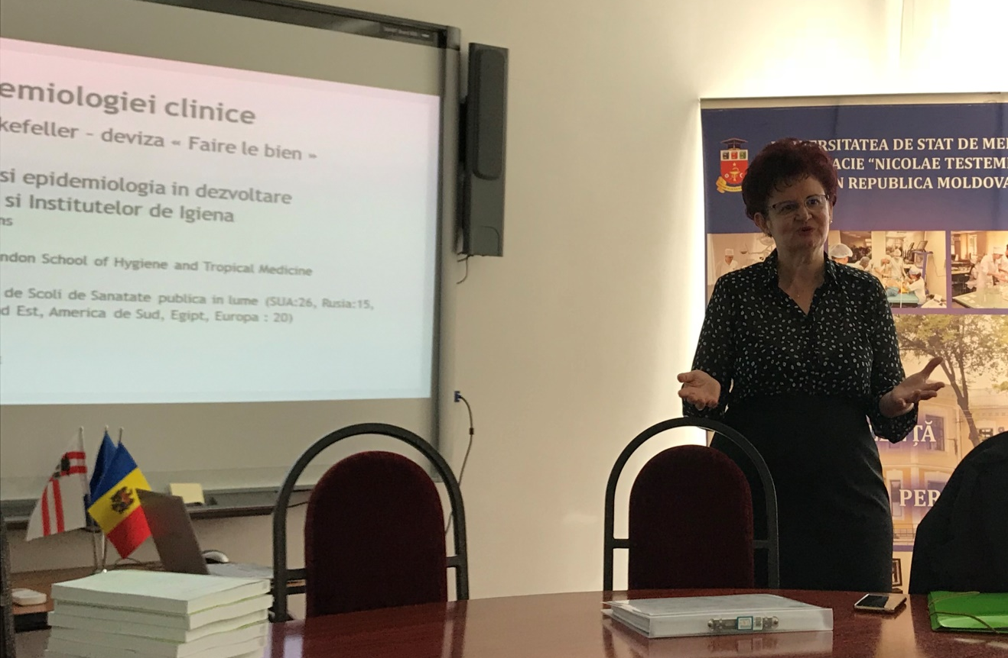
Team training: module 1
The purpose of the first training module was to present the basic elements regarding the types of study, the research protocol, aspects related to the descriptive and analytical statistics used in medical research, the method of critical evaluation of the medical literature, etc.
The course was supported by Azoicai Doina, university professor, University of Medicine and Pharmacy "Gr. T. Popa ”from Iasi, Romania.

Slide 18
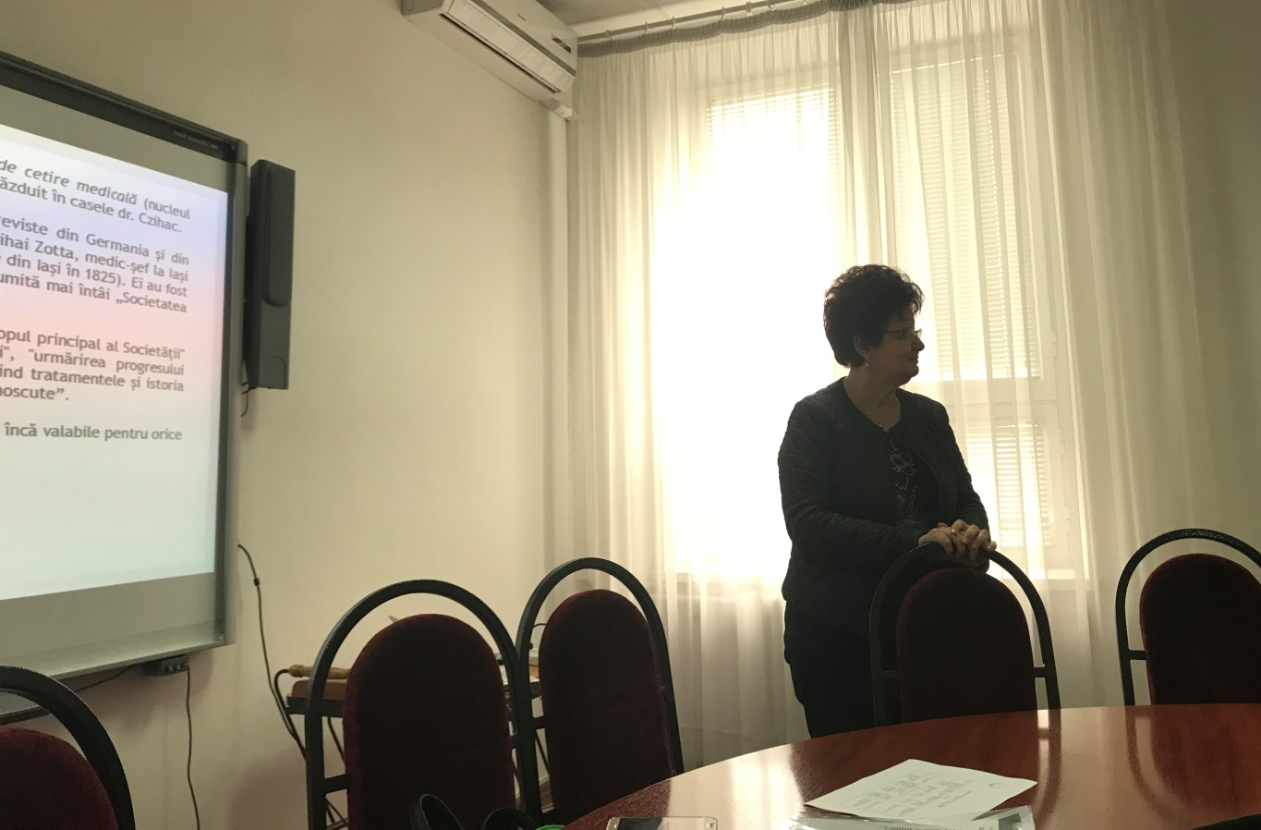
Team training: module 2
At the second training module in period 23 to 28 September 2018, the trainers were Mrs. Azoicăi Doina and Mr. Cristian-Rasvan Băicuș, university professor, "Carol Davila" University of Medicine and Pharmacy of Bucharest, Romania

Slide 19
Team training: module 3
The trainers were Mrs. A zoicăi Doina and Mr. Vladimir Bacârea, university professor, University of Medicine, Pharmacy, Science and Technology, Tîrgu Mureș, Romania
The trainers were Mrs. A zoicăi Doina and Mr. Vladimir Bacârea, university professor, University of Medicine, Pharmacy, Science and Technology, Tîrgu Mureș, Romania
Participants performed a critical analysis of a quality of life study and compared the multiple averages using the statistical indicators Kruskall Wallis and Mann Whitney.
Were presented linear and multiple regressions, interpretation based on the Kaplan Mayer regression model and performed processing through the Graph Prism program

Slide 20
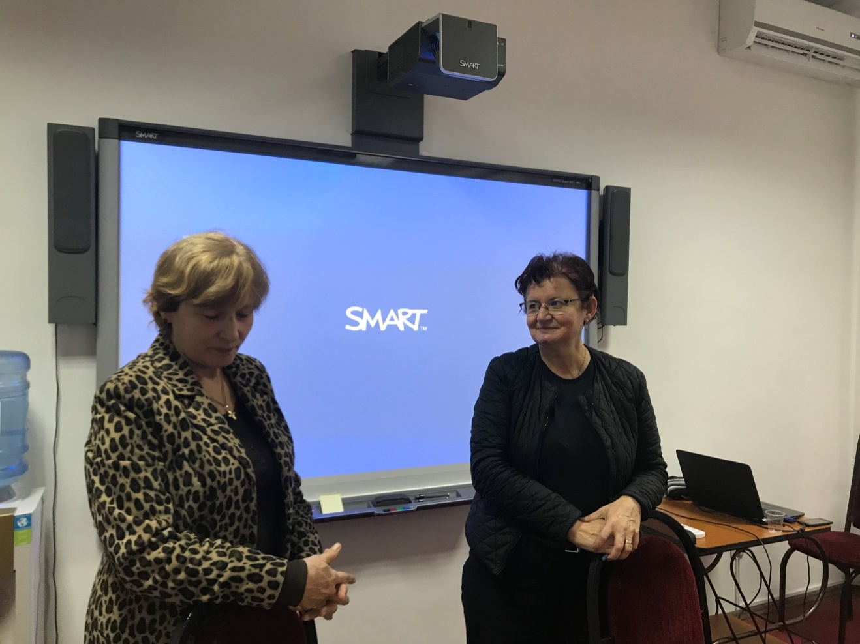
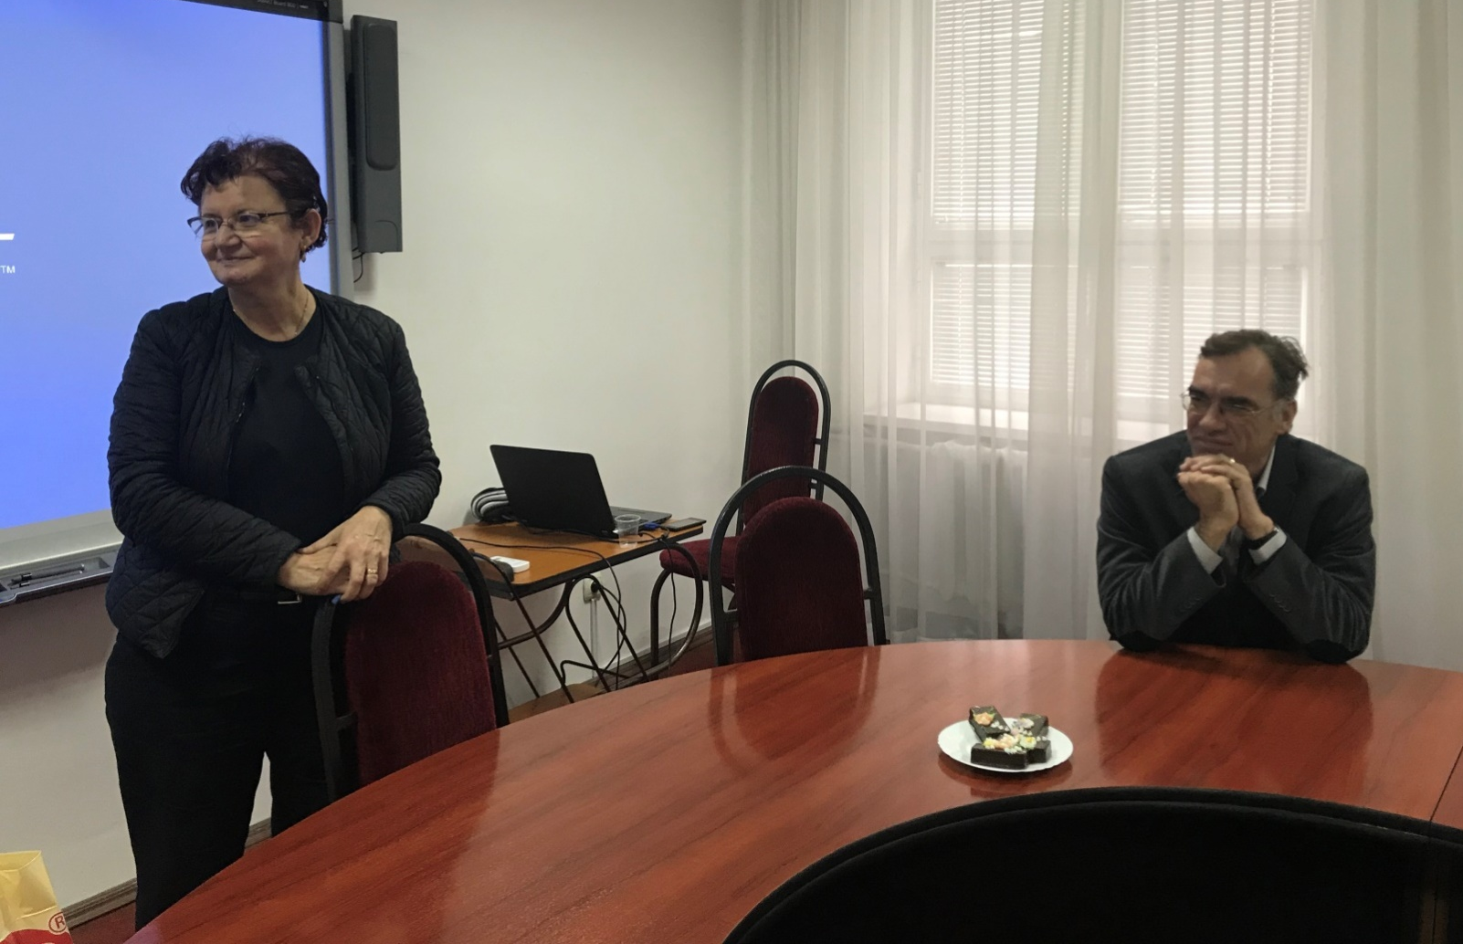
Team training: module 3

Slide 21
Team training: module 4
The training course was finished with module held between February 16-23, 2019
Was moderated by Ms. Azoicai Doina and Mr. Pierre Duhaut, university professor, University of Picardy "Jules Verne", France.

Slide 22
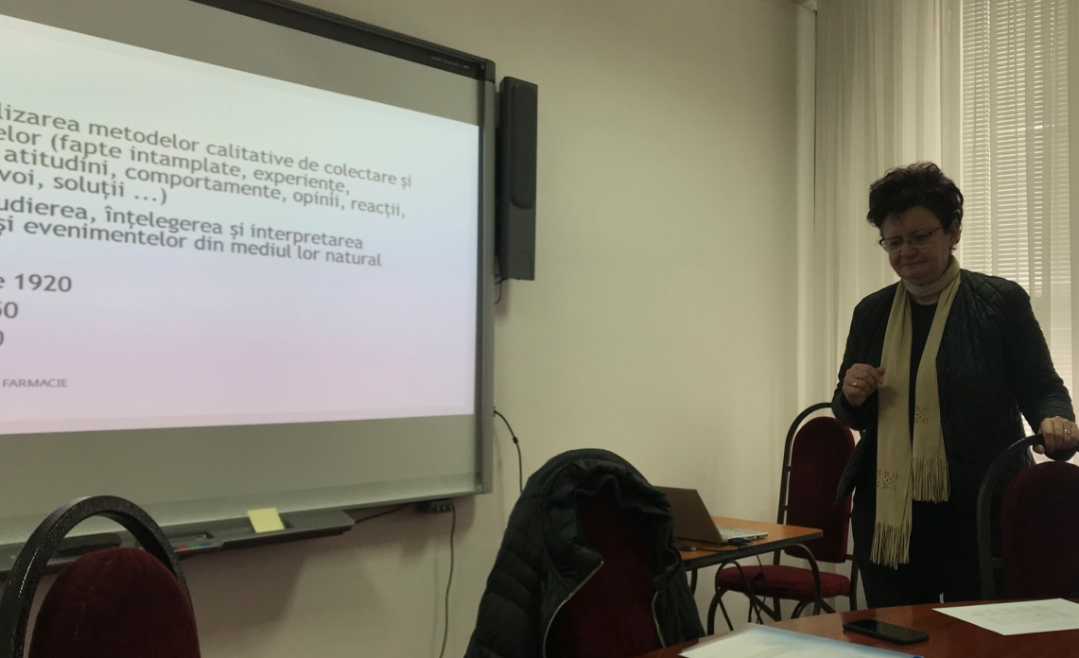
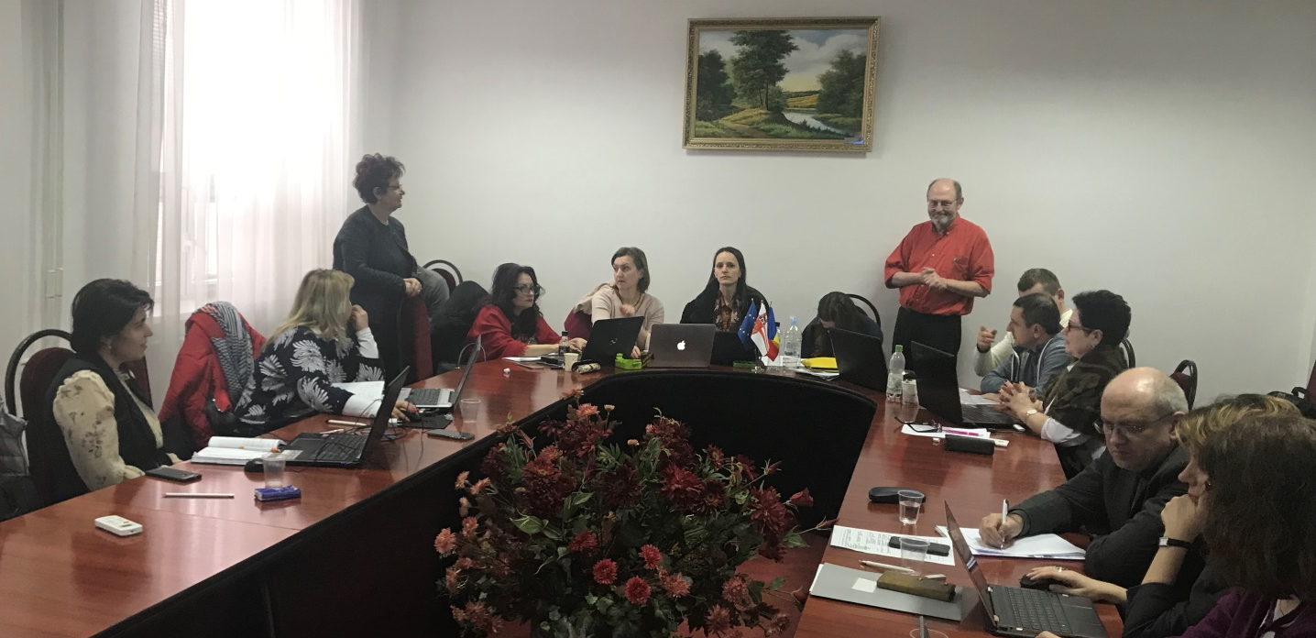
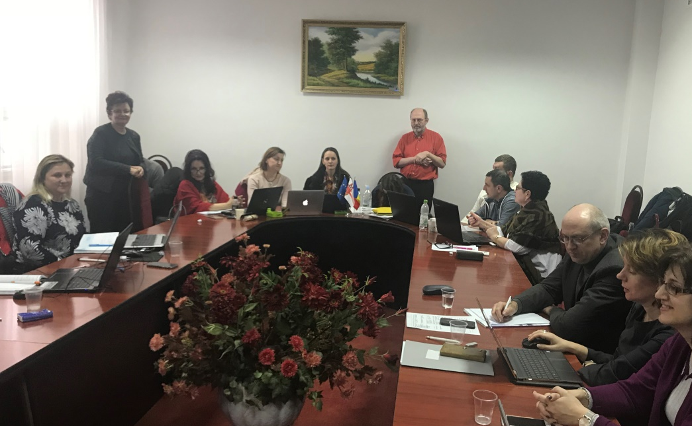
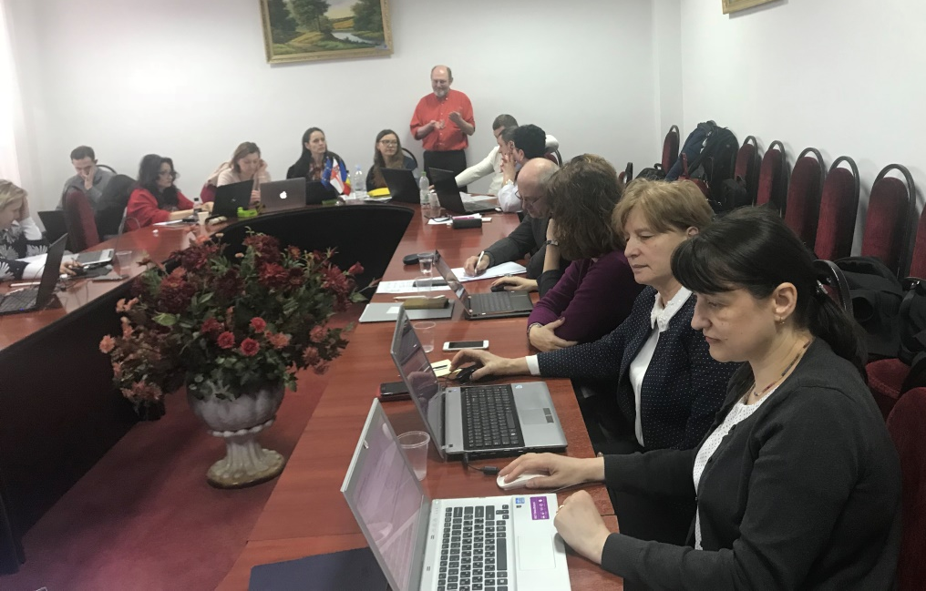
Team training: module 4

Slide 23
Establishment of CEU
On May 20, 2019, order nr. 145-A of the rector
Spinei Larisa, PhD MD, University Professor
Hadjiu Svetlana, PhD MD, University Professor
Spinei Aurelia, PhD MD, Associate Professor
Adauji Stela, PhD PD, Associate Professor
Arnaut Oleg, PhD MD Associate Professor,
Vetrilă Snejana, PhD MD, Associate Professor
Banov Pavel, PhD MD, Assistant.

Slide 24
At present
From beginning of the academic year 2019-2020 the Clinical Epidemiology Unit of Nicolae Testemitanu State University of Medicine and Pharmacy was prepared for the international accreditation which starts, in accordance with the requirements of RECIF

Slide 25
CLINICAL EPIDEMIOLOGY UNIT
MAIN TEACHINGS, COURSES IN RESEARCH METHODOLOGY CURRENTLY ORGANIZED BY UEC MEMBERS
Part 3

Slide 26
MAIN TEACHINGS, COURSES IN RESEARCH METHODOLOGY FOLLOWED BY UEC MEMBERS
No | Name of the discipline | Mandatory/optional | Lecturer
6th level ISCED/6EQF/1QF-EHEA, Higher education, full-time, first cycle license: 4 years with 240 ETCS credits: Optometry, General nursing
1. | Biostatistics. Methodology of scientific research. Evidence-based medicine | Mandatory, II year | Spinei Larisa, PhDH MD, professor
7th level ISCED/7EQF/2QF-EHEA, integrated higher education, I + II cycles, full-time: Medicine (6 years, 360 ETCS credits); Preventive medicine (6 years, 360 ETCS credits); Dentistry (5 years, 300 ETCS credits);
2. | Biostatistics. Methodology of scientific research. Evidence-based medicine | Mandatory, II year | Spinei Larisa, PhDH in medicine, professor
3. | Methodology of scientific research for the license thesis | Optional, IV year | Spinei Larisa, PhDH in medicine, professor
4. | Evidence-based medicine: critical analysis of medical articles | Optional, IV year | Spinei Larisa, PhDH in medicine, professor

Slide 27
MAIN TEACHINGS, COURSES IN RESEARCH METHODOLOGY FOLLOWED BY UEC MEMBERS
No | Name of the discipline |  |  | Mandatory/ optional |  | Lecturer
7th level ISCED/7EQF/2QF-EHEA, integrated higher education, I + II cycles, full-time: Pharmacy (5 years, 300 ETCS credits);
5. | Discipline Social Pharmacy, module: Domains and study methods of social pharmacy; Theoretical bases of pharmacoeconomics and of pharmacoepidemiology; |  |  |  | Mandatory, V year | Adauji, PhD in pharmacy, associate professor
8th level ISCED/8EQF/3QF-EHEA higher education, III cycle doctoral program (46 programs 180 ETCS credits each)
1. | Methodology of scientific research | Mandatory |  | Spinei Larisa, PhDH in medicine, professor
2. | Biostatistics | Mandatory |  | Arnaut Oleg, PhD in medicine, associated professor
3. | Evidence-based medicine | Mandatory |  | Spinei Larisa, PhDH in medicine, professor
Postgraduate residency studies lasting 2-5 years on 63 specialties
1. | Methodology of scientific research |  | Mandatory | Spinei Larisa, PhDH in medicine, professor
2. | Critical analysis of medical articles |  | Mandatory | Spinei Larisa, PhDH in medicine, professor

Slide 28
CLINICAL EPIDEMIOLOGY UNIT
PROJECTS REALIZED (OR IN PROGRESS) WITHIN THE MEMBERS EUC
Part 4

Slide 29
01
02
03
36
16
3
Projects for doctoral students
Projects realizid
Projects in progress
PROJECTS REALIZED (OR IN PROGRESS)

Slide 30
Projects realized
SPINEI Larisa, PhD in medical science, University Professor

Slide 31
Projects for doctoral students
No. | Project Name | Group of authors
(1) | Quality of life of patients with comorbid pathologies in the gut | Groppa L, Spinei L, Rotaru L.
(2) | Clinical management of people with severe mental disorders: diagnosis, rehabilitation and psychosocial integration | Nacu A, Spinei L, Chihai J.
(3) | Epidemiology, determinants and predictions of ischemic stroke а the children | Hadjiu S, Revenco N, Spinei L, Sprincean M.
(4) | Risk management in neurosurgical assistance | Spinei L, Zapuhlih G, Danu S.
(5) | Health status of the population measured by preventable mortality and disease burden | Spinei L, Cernelea D.
(6) | Quality of life of the child after pediatric stroke: medico-social considerations | Hadjiu S, Revenco N, Spinei L, Vovc V, Lupușor N.
(7) | Management of the medico-social conduct of the elderly patients with hypertension | Bodrug N, Spinei L, Negara A, Negrean M.
(8) | Improvement of the management of the pharmaceutical service under the current conditions of development of the health system | Safta V, Spinei L, Adauji S.

Slide 32
Projects realized in the various scientific programs (participation)
No. | Project Name | Years of development
(1) | Factors Associated with Burnout in Medical Academia: An Exploratory Analysis of Romanian and Moldavian Physicians | (2018-2019)
(2) | Assessment of the quality of life of the third / retirement age | (2018-2019)
(3) | Health workers from the Republic of Moldova | (2016)
(4) | UNDP project “Analysis of the Health Status Through Statistical Indicators” | (2015-2016)
(5) | Project of Regionalization of the Pediatric Emergency and Intensive Care Services in Moldova REPEMOL | (2012-2014)

Slide 33
Projects realized
HADJIU Svetlana, PhD in medical science, University Professor

Slide 34
Projects for doctoral students
No | Project Name | Group of authors
(1) | Epidemiology, determinants and prediction of ischemic stroke in children | Hadjiu S, Revenco N, Spinei L, Sprincean M.
(2) | Quality of life of the child after pediatric stroke: medico-social considerations | Hadjiu S, Revenco N, Spinei L, Vovc V, Lupușor N.
(3) | Supra-segmental vegetative dysfunctions in patients with cerebellar tumors in the late postoperative period | Hadjiu S., Litovcenco A., Grîu C.
(4) | The peculiarities of epilepsies of drug-resistant epilepsy in children: clinical-neurophysiological study | Hadjiu S, Groppa S, Feghiu L.
(5) | Cerebral palsy in children - conceptual medico-psychosocial approach in determining disability | Hadjiu S, Revenco N, Cuzneț L.
(6) | The role of determinants in the onset of neurological disorders in children with acute respiratory disorders | Hadjiu S, Revenco N, Eremia R.

Slide 35
Projects realized in the various scientific programs (participation)
No | Project Name | Years of development
(1) | Assessing of incidence, prevalence, risk factors, research of clinical, neuroimaging, neurophysiological and remediat neurotrophic strokes in children | Projects within the state programs (2016-2018)
(2) | Neuropsychological development and neurological evaluation of infants and young children, project on editing scientific monographs | Project from the State Register (2014)
(3) | Health workers from the Republic of Moldova | (2016)
(4) | Early prophylaxis and preventive treatment of nervous system pathology in children | Grant project of AS RM (2008-2010)
(5) | Evaluation of the determinants of morbidity and mortality of children by genetic diseases and their prophylaxis in the population of the Republic of Moldova | Institutional projects, 15.817.04.32A (2014-2018)

Slide 36
Projects realized
ADAJI Stela,
PhD in pharmacy science, associate professor

Slide 37
Projects for doctoral students
No | Project Name | Group of authors
(1) | Management of pharmaceutical assistance for persons with advanced vision | Adauji S, Safta V, Brumărel M
(2) | Studies on improving the pharmaceutical care of patients with rare diseases | Adauji S, Safta V, Brumărel M, Revenco N.
(3) | The particularities of the pharmaceutical assistance of the children in ambulatory and stationary conditions | Adauji S, Safta V, Brumărel M, Revenco N.

Slide 38
Projects realized in the various scientific programs (participation)
No | Project Name | Years of development
(1) | Internațional: Medicines prices, availability, affordability and price components in the Republic of Moldova | Joint project SM RM, WHO, AM DM, SUMF „Nicolae Testemitanu” (2011)
(2) | Bilateral project "Pharmaceutical and economic aspects in the treatment of patients with tuberculosis comparative study: Romania / Moldova" | In partnership with Moldova-Romania. The beginning of the 2013 project, in progress.
(3) | Availability and accessibility, including financial, for opioids ”, Consultant for estimating the real opioid needs in the Republic of Moldova | According to by the Soros-Moldova Foundation (14.04.2016-31.05.2016)
(4) | Availability and accessibility, including financial, to opioids, Consultant for the elaboration of the Roadmap for ensuring the availability of oral morphine for patients in need of palliative care in the Republic of Moldova | Grant project of AS RM (01.08.2017-30.09.2017)
(5) | Nicolae Testemițanu SUMPh, RM – UMF „Gr. T.Popa” Iasi, Romania: Project de recherché conjointe AUF-IFA – „Synthesis of bioactive molecules with anti-inflammatory action” – BioCheminflam | Bilateral project in progress: (24.04.2019-31.12.2020)

Slide 39
Projects realized
SPINEI Aurelia,
PhD in medical science,
University Professor

Slide 40
Projects for doctoral students
No | Project Name | Group of authors
(1) | Application of photodynamic therapy in the mini-invasive treatment of dental caries | Spinei A, Forna N, Spinei L.
(2) | Prevention of early severe caries in temporary dentition | Spinei A.
(3) | Dental enamel hypoplasia in children | Spinei A, Forna N, Spinei L.
(4) | Particularities of diagnosis and treatment of marginal periodontal diseases in children with diabetes mellitus | Spinei A, Foia L, Spinei L.
(5) | Evaluation of efficiency of the use of zinc compounds in the prevention of dental caries in children | Spinei A,Tagadiuc O.
(6) | The particularities of dental care in children with dental anxiety at pre-school age | Spinei A.

Slide 41
Projects realized in the various scientific programs (participation)
No | Project Name | Years of development
(1) | Collaboration for education and research in oral pathology between Norway, Moldova, Belarus and Armenia | International project, 2016-present, in progress
(2) | Réaliser un réseau régional interdisciplinaire de formation à la recherche visant l’impact de la maladie de reflux gastro-œsophagien sur les structures dentaires afin de mettre en place une stratégie concernant la prophylaxie et la thérapie pour améliorer la qualité de vie et de santé des patients visés | International project Projet de formation a la recherche AUF Bureau Europe Centrale et Orientale, 2012-2015)
(3) | Dental care in children with disabilities, project on the editing of scientific monographs (valuable works) for 2016. | Project within the State Register (2016)

Slide 42
Projects realized
VETRILA Snejana,
PhD in medical science, associate professor

Slide 43
Projects for doctoral students
No | Project Name | Years of development
(1) | Clinical and laboratory features of idiopathic inflammatory myopathies | PhD thesis
(2) | Attitudes and practices of family doctors in the control of cardiovascular diseases | Master's thesis
(3) | Thesis license | 5

Slide 44
Projects realized
ARNAUT Oleg,
PhD in medical science, associate professor

Slide 45
Projects for doctoral students
No | Project Name | Group of authors
(1) | Postoperative analgesia by tight plane block in thoracotomy surgery: anatomical argumentation and clinical efficiency | Sandru S, Arnaut O, Câvârjic I.
(2) | Approaching the ways to optimize anesthetic risk management | Sandru S, Arnaut O, Sisiianu Gh.
(3) | Traumatic scores in intensive care. Comparative evaluation and validation | Sandru S, Arnaut O, Grabovschi I.
(4) | Severe trauma: models for predicting the evolution and results of the treatment | Sandru S, Arnaut O, Rojnoveanu Gh, Saulea A.
(5) | Evaluation of the protease-antiprotease system in acute pulmonary dysfunction | Sandru S, Arnaut O, Saulea A.

Slide 46
Projects realized in the various scientific programs (participation)
No | Project Name | Years of development
(1) | Postdoc position. INSERM, Toulouse, France | Medea project (2015-2016)

Slide 47
Projects realized
BANOV Pavel,
PhD in medical science, assistante

Slide 48
Projects for doctoral students
No | Project Name | Group of authors
(1) | Contemporary management of recurrent urolithiasis metaphylaxis | Banov Pavel
(2) | “The East European Network of Excellence for Research and Development in Chronic Diseases CHRONEX-RD" Exchange „Eugen Ionescu", Cluj-Napoca, Romania | 12.01.2015 - 12.03.2015 01.04-29.06.2015

Slide 49
CLINICAL EPIDEMIOLOGY UNIT
MAIN PUBLICATIONS AND SCIENTIFIC COMMUNICATIONS OF MEMBERS UEC
Part 5

Slide 50
Larisa Spinei
Publi-cations
117
38
4
117
5
articles and theses
materials of scientific communications
course notes for students
methodological indications for students (author and co-author)
manuals for students, masres students, Phd students

Slide 51
Svetlana Hadgiu
Publi-cations
429
216
129
2
13
14
Articles and theses
Materials of scientific communications
Monographs
Posters
Patents for inventions
Clinical protocols

Slide 52
Stela Adauji
86
articles and theses;
1
38
materials of scientific communications
2
5
Manuals and course notes for students, residents and pharmacists
3
4
21
methodological indications for students

Slide 53
Aurelia Spinei
165
articles and theses;
1
articles in international scientific journals rated ISI and SCOPUS;
9
2
53
materials of scientific communications
3
2
textbooks for students, residents and doctors
4
5
2
monographs

Slide 54
Snejana Vetrilă
Publications in the last 5 years
40
articles and theses;
textbooks for students
3
40
materials of scientific communications

Slide 55
Author and co-author of over 54publications including in international editions and with impact factor.
Oleg Arnaut
Author and co-author of over 54publications including in international editions and with impact factor.
Pavel Banov

Slide 56
CLINICAL EPIDEMIOLOGY UNIT
Part 6
CLINICAL EPIDEMIOLOGY UNIT DEVELOPMENT PROJECTS FOR THE FOLLOWING 5 YEARS

Slide 57
OBJECTIV
Participation in verification committees of primary material, providing support in conducting research based on correct methodology
Continuing education of CEU members in research methodology, biostatistics, evidence-based medicine
01
04
02
Organizing seminars for PhD thesis supervisors in research methodology and methods for analyzing results with training of people trained by RECIF
03
Providing consultations to academic community of Nicolae Testemitanu State University of Medicine and Pharmacy in planning research projects, in structuring of multidisciplinary research protocols

Slide 58
OBJECTIV
Academic mobility of CEU members
Providing consultations in the preparation of reports for scientific conferences
05
08
06
Collaboration with other CEUs (Romania, France, etc.)
07
Reviewing monographs, articles, national and institutional projects, theses and PhD

Slide 59
OBJECTIV
Participation in the elaboration of Regulation for standardized activity of all CEUs
09

Slide 60
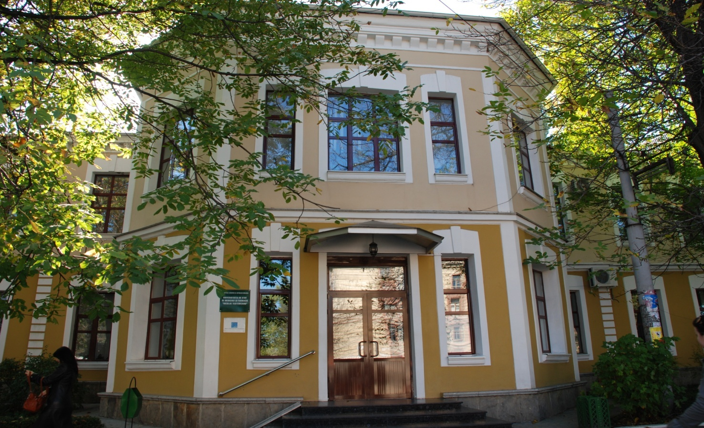
Thank you for your attention!

